Slide 1
Final Presentation
Group 11

Slide 2
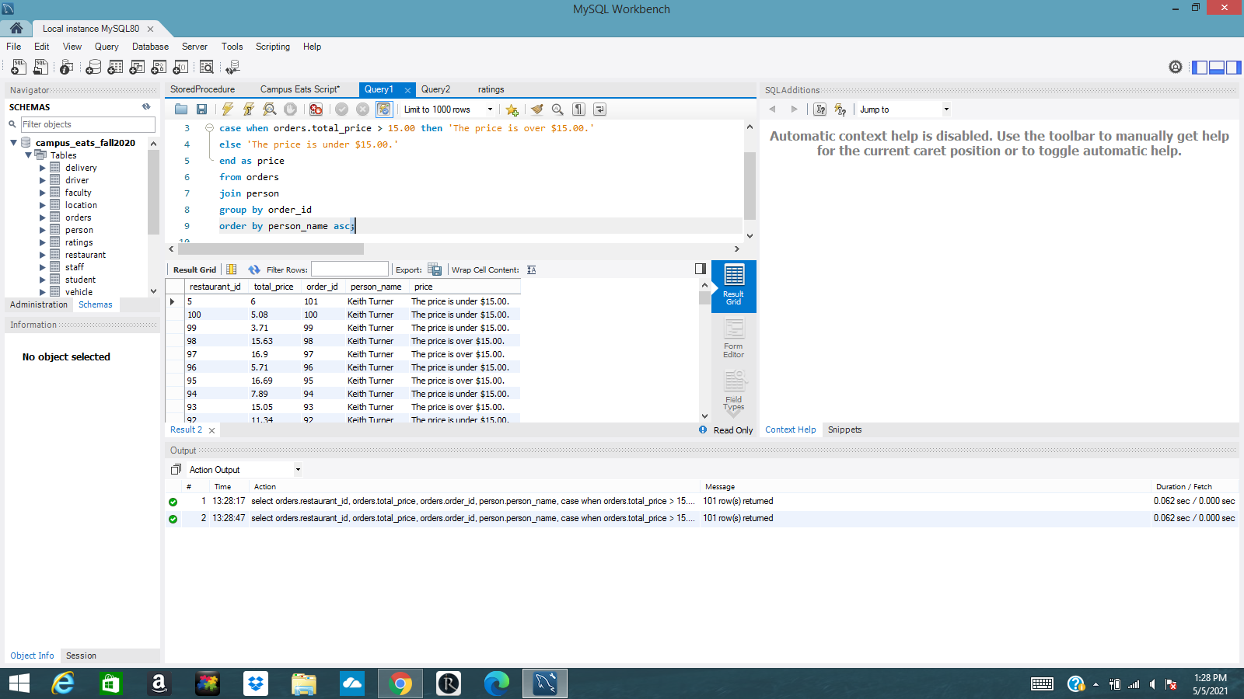

Query 1

Slide 3
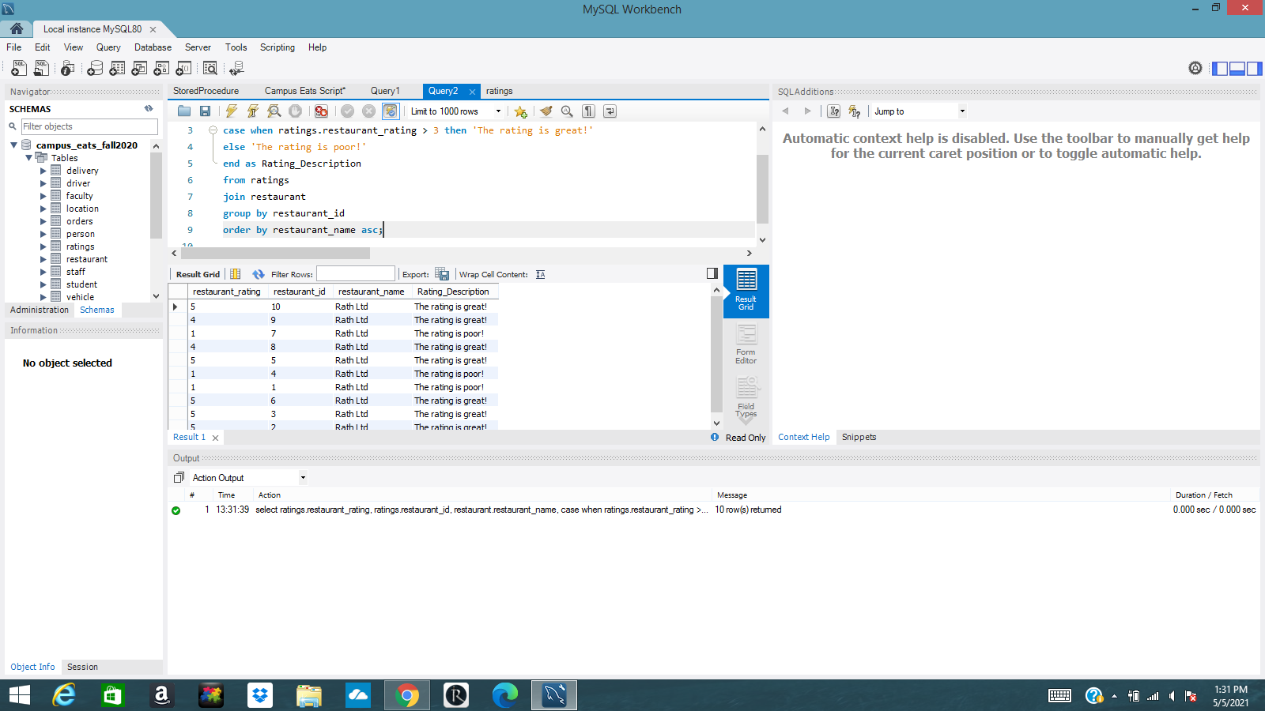
Query 2

Slide 4
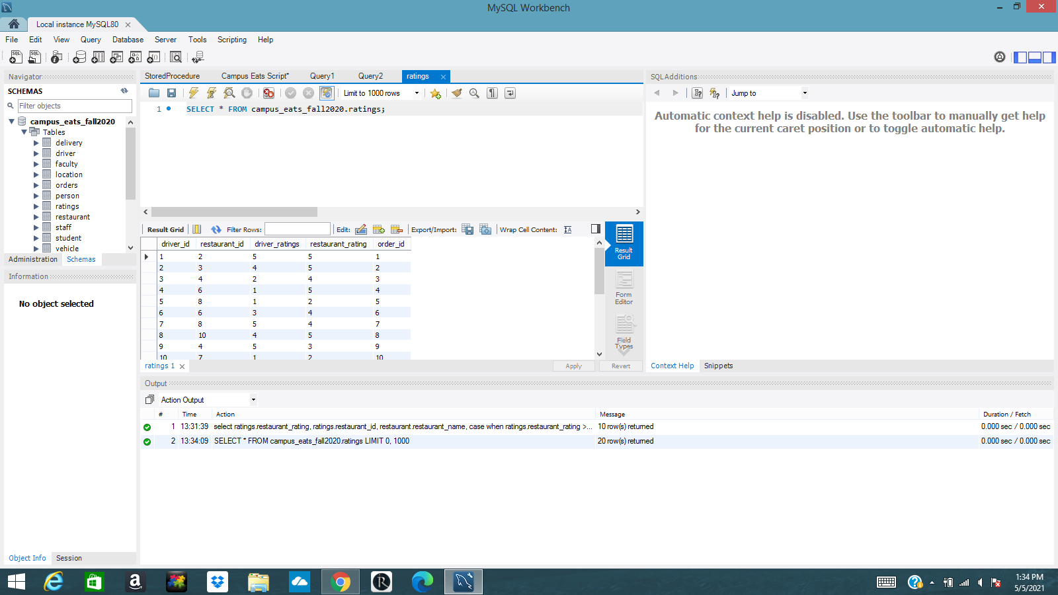
Ratings Table

Slide 5
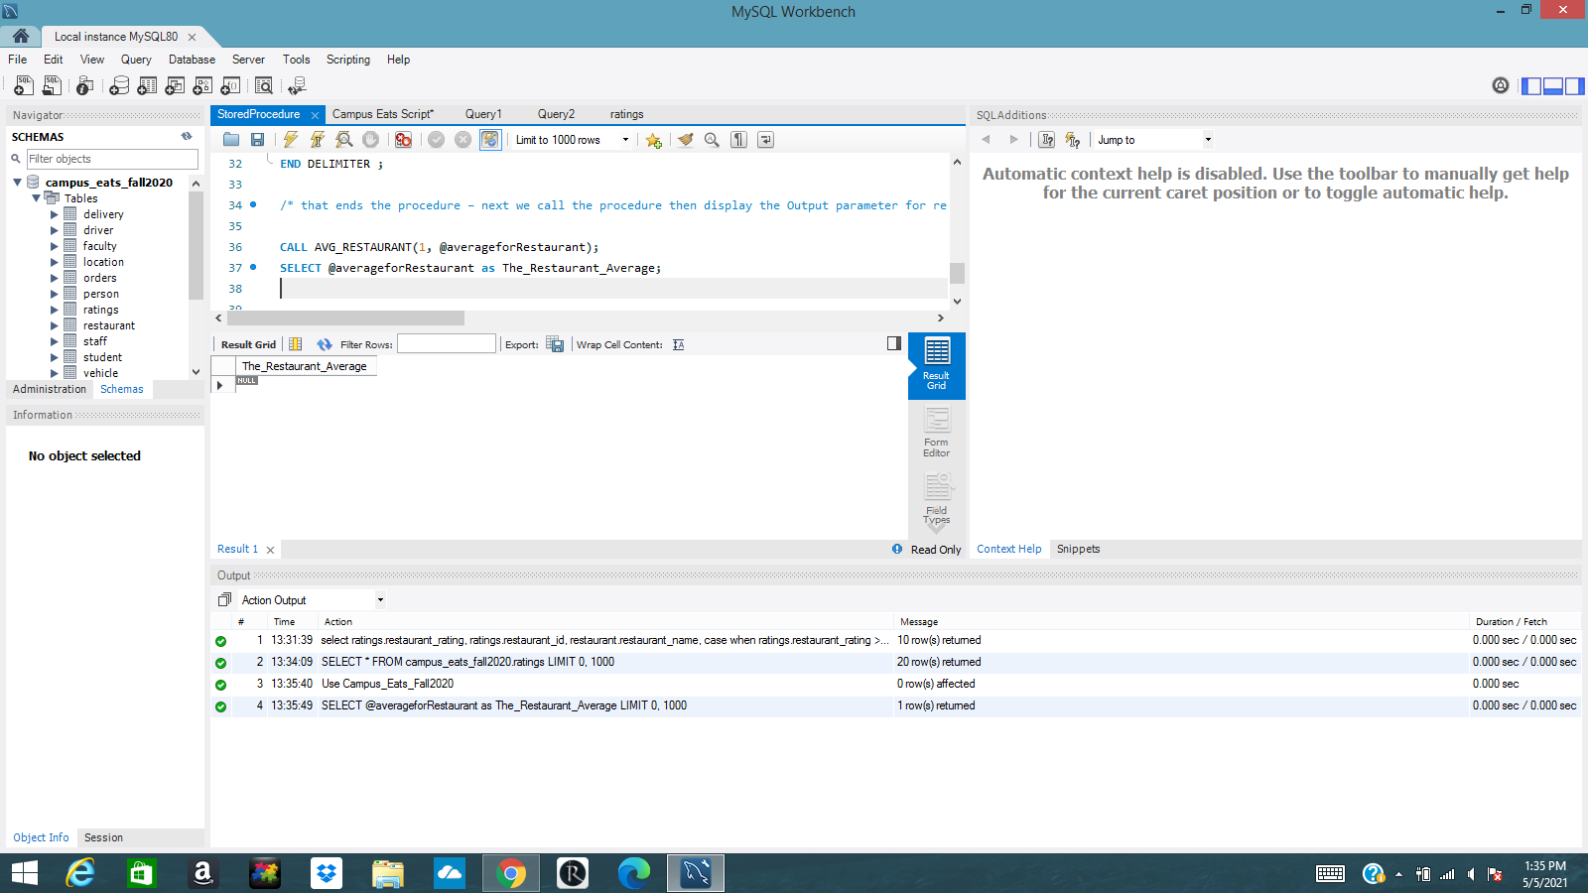
Stored Procedure

Slide 6
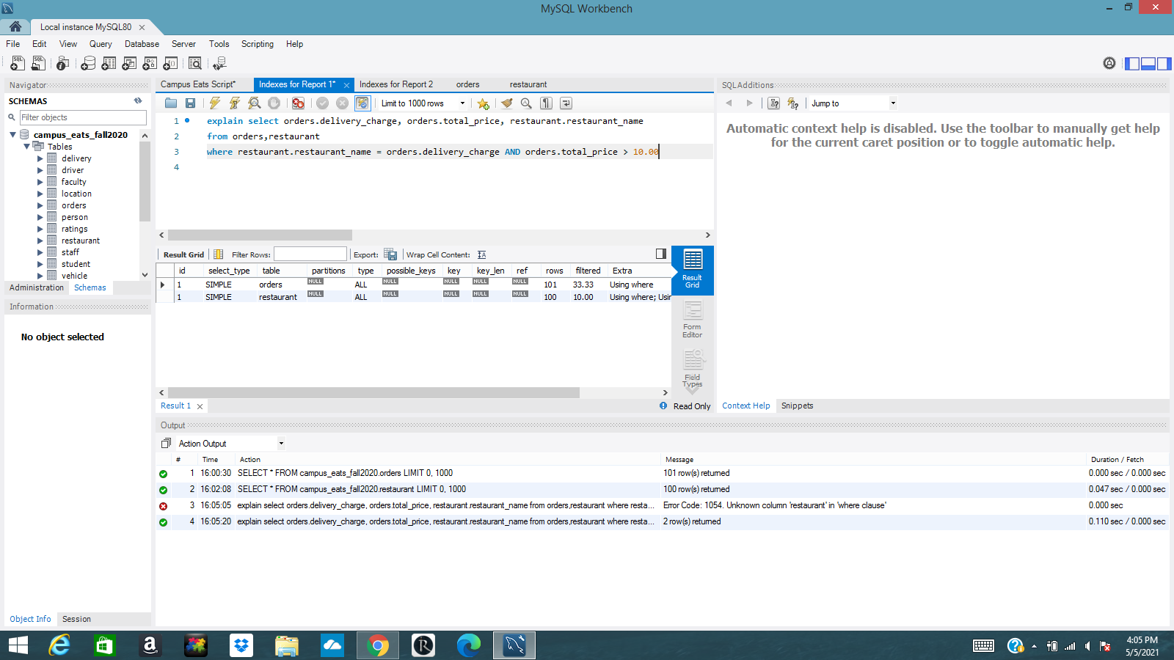

Indexes for Report 1

Slide 7
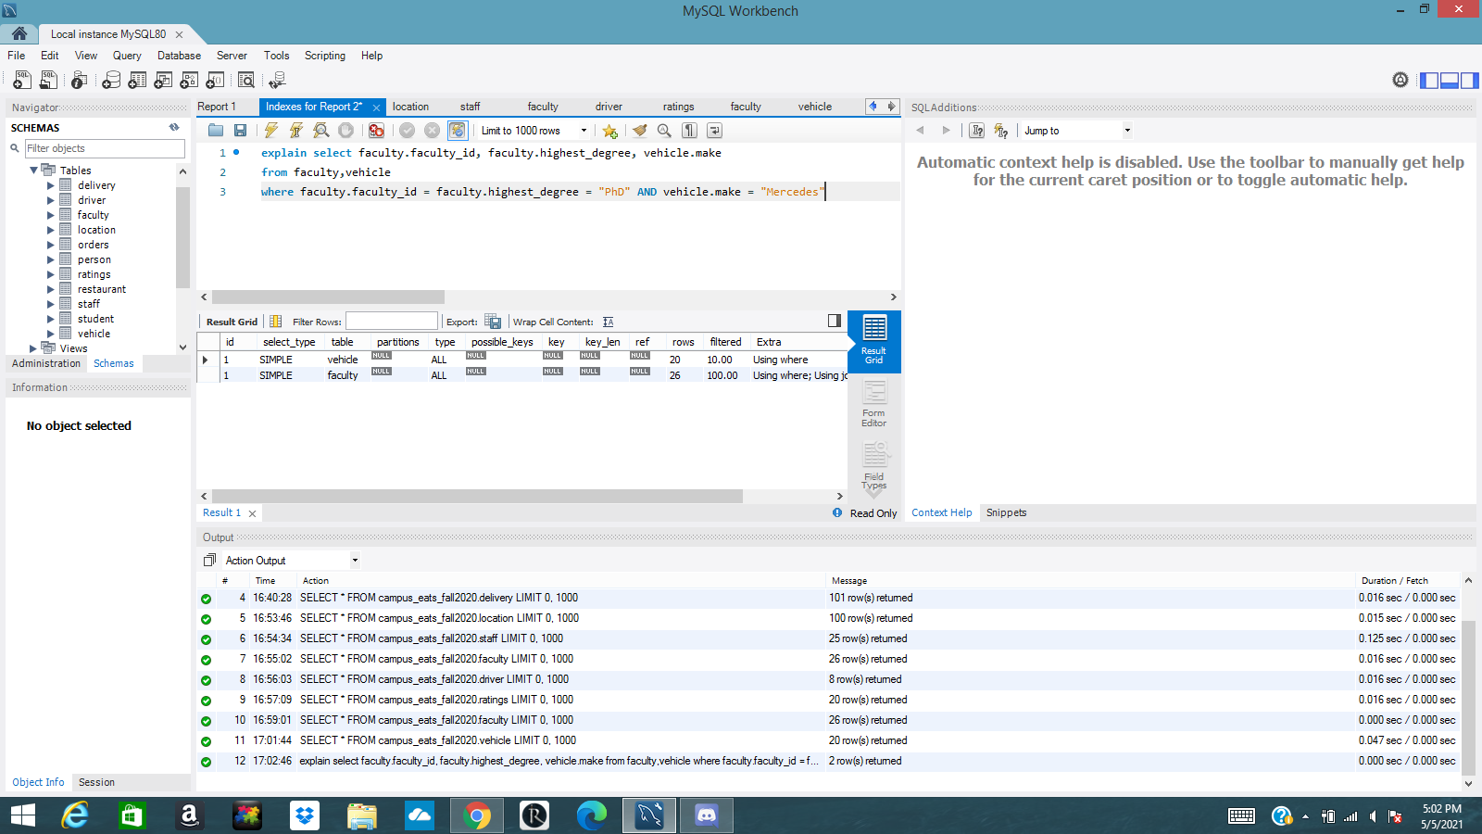

Indexes for Report 2

